Slide 1


Mini Project
On
Online Library Management System
By
Team VAS
Vikaram Pratap-2001330140062
Abhishek Singh-2001330140004
Satyam Kumar-2001330140046

Slide 2
Introduction:
◆ Main users of this system is Librarian and Students.
◆ This project is based on Web using PHP, HTML & CSS in front end and In Back end-MySQL.
◆ Library provides facility and peaceful atmosphere to students.
◆ Students can take books easily and get new books as they
demand in future.

Slide 3
Aims and Objectives:
Aims:
To provide information on any book present in library to the user who uses it.
To develop a system that can handle and accomplish the activities involved in a library in an effective and reliable way.
To gives easy way to connect with the library by taking books easily.
Objectives:
Attractive user interfaces to navigate through the system for the users.
We want to gives knowledge about
online library to students.
To Provides Online Reading Services in the near future as well.
Giving easy access to the users or members.

Slide 4
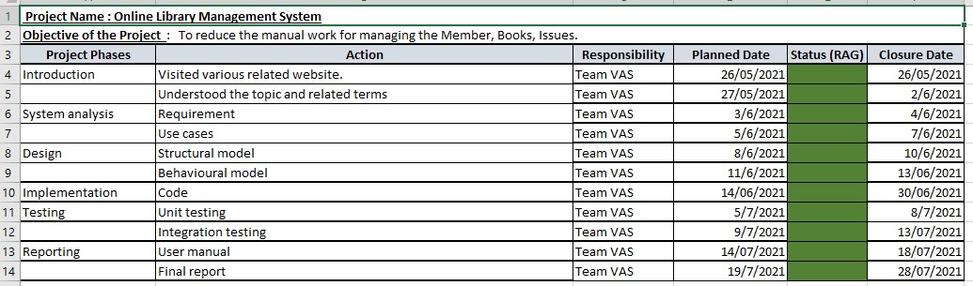
Project Plan:

Slide 5
Analysis: Requirement
◆ Login/Authenticate User
◆ Add New User/Member
◆ Insert Book’s Details
◆ Remove Members/Users
◆ Search Book
◆ Quick Data Insert/Retrieve
◆ Request Book

Slide 6
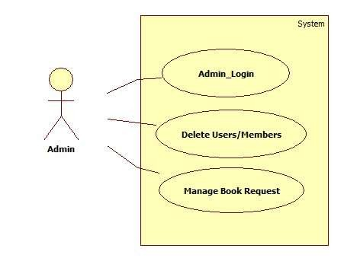
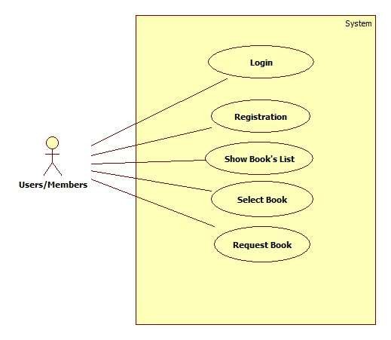
Analysis: Use Case

Slide 7
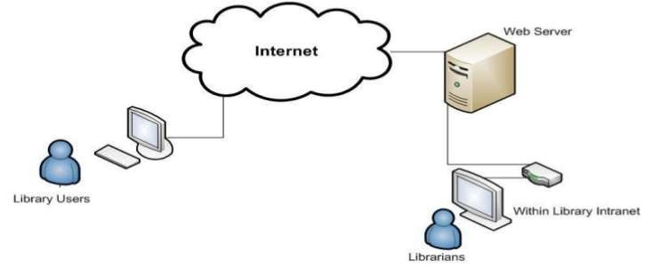
Analysis: Architecture

Slide 8
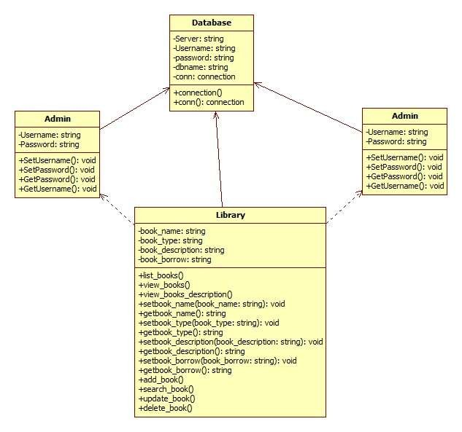
Design: Class Diagram

Slide 9
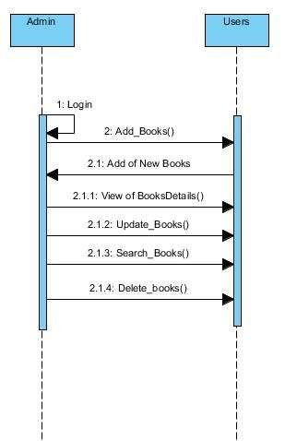
Design: Sequence Diagram

Slide 10
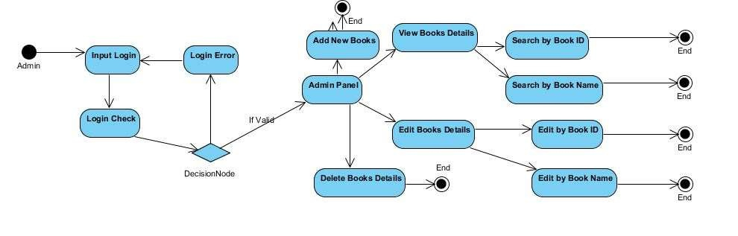
Design: Activity Diagram

Slide 11
Implementation:
We have used the programming languages like PHP, HTML, CSS [Web Based] and MySQL.
In Development Environment XAMMP is used as local server.
For Coding we used Visual Studio Code.
As a Operating system we use WINDOWS 10.
Main things in implementation is connecting to local server for gaining information's of requirements in the library.

Slide 12
Test Case/Scripts:
Test Case | Title | Description | Expected Result | Actual Result
1 | Admin Login | To Access into the system Admin must Login First. | If Username and Password is correct then Admin will be Login. | Successfully Login.
2 | Edit Users and Books details | After inserting data into the system then admin can remove and modify the users and books. | Can change the inserted information. | Editing the Data from the system.
3 | Search Users and Books details | Admin will find books and users by the given id. | Searching the information. | Find out Books and Users.
4 | View Users and Books Details | Admin can view and modify the information | Getting all the information of users and books. | View the information of users and books.
5 | Delete Users and Books Details | Admin can delete the users if they are out of contact and books which is old. | Remove all the unwanted users and books. | Successfully Removed the information which is stored in the database.

Slide 13
Future Works:
In the near future, technology is growing rapidly and so this
“Library Management” will be very helpful in the future.
Every College and Local Library can use this system.
Easy to Access and No loss of time.
In future, users can read online books like [.pdf] from library just by logging their account.

Slide 14
Reflection in this Project:
◆ Got Few Problems in Code and it’s gain lots of time to fix.
◆ Didn’t go as a plan, actually in time management.
◆ In last should do in hurray.so, In near future it will help for doing pressure things.
◆ During Coding phase, Doing lots of research helps to build great learning platform.
◆ In the near future, we will do lots of projects in our career and
this will help us to build strong foundation.

Slide 15
Conclusion:
◆ Hence, we have completed our project without any problems.
We have done various research for this project and this system is designed using PHP and HTML in the front end and MySQL in the back-end database.
◆ We have used CRUD Functions in it, just which is regularly used in the library. This system helps in the college and local libraries where works makes easy for librarian and users.
◆ This Project has been developed by considering all the needs given through interaction with the users of the system.

